Slide 1
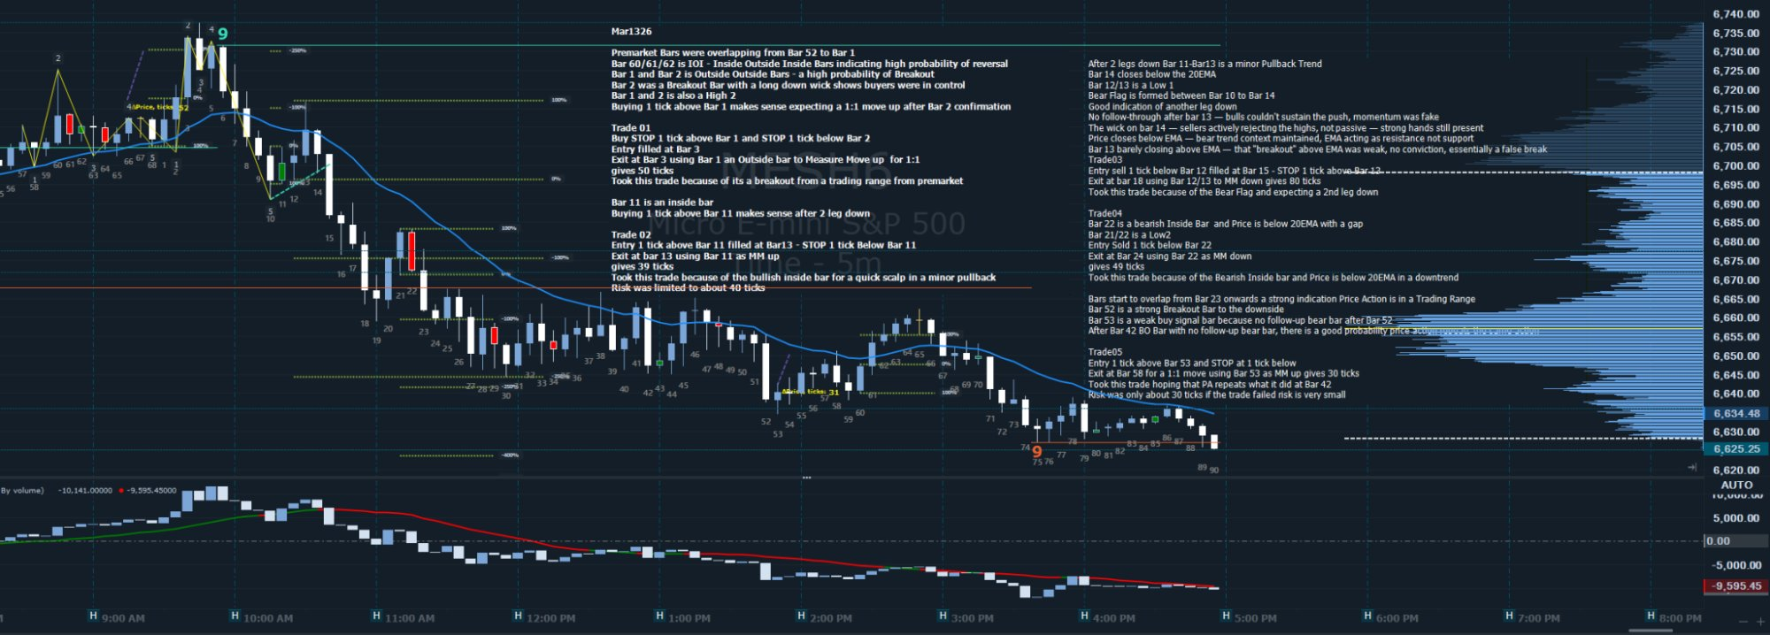



EOD REVIEW · MES · 5-Minute Bars
Mar 13, 2026
PRE-MARKET CONTEXT
Bars 52–1 overlapping (IOI pattern) → high probability reversal · Bar 2 = Outside Outside Bar (Breakout) · Bar 2 has long lower wick → buyers in control · Bars 1 & 2 = High 2 · Expect 1:1 move up after Bar 2 confirmation
T01
LONG
T02
LONG
T03
SHORT
T04
SHORT
T05
LONG
Bars 1–3
Bars 11–13
Bars 12–18
Bars 22–24
Bars 53–58
ENTRY
+39 ticks
ENTRY
ENTRY
+80 ticks
ENTRY
+49 ticks
ENTRY
+30 ticks
Buy STOP 1 tick above Bar 1 · STOP 1 tick below Bar 2
Buy STOP 1 tick above Bar 11 filled at Bar 13 · STOP 1 tick below Bar 11
Sell STOP 1 tick below Bar 12 filled at Bar 15 · STOP 1 tick above Bar 12
Sell STOP 1 tick below Bar 22 · Entry Bar 21/22 = Low 2
Buy STOP 1 tick above Bar 53 · STOP 1 tick below Bar 53
EXIT
EXIT
EXIT
EXIT
EXIT
Exit Bar 3 using Bar 1 as Outside Bar to measure move · 1:1R
Exit Bar 13 using Bar 11 as MM up · 39 ticks
Exit Bar 18 using Bar 12/13 MM down · 80 ticks
Exit Bar 24 using Bar 22 as MM down · 49 ticks
Exit Bar 58 at 1:1 MM using Bar 53 · 30 ticks
REASON
REASON
REASON
REASON
REASON
Breakout from pre-market trading range · Bar 2 BOO
Bar 11 = inside bar · Bullish scalp after 2-leg pullback
Bear Flag Bars 10–14 · Expecting 2nd leg down · Bar 13 = Low 1
Bearish inside bar · Price below 20 EMA with gap · Downtrend context
Bar 52 = strong BO bar down · Bar 53 = weak buy signal · PA repeating Bar 42 pattern
+39 ticks
EOD Review: March 13, 2026 · MES 5m · Personal trade journal — not financial advice

Slide 2
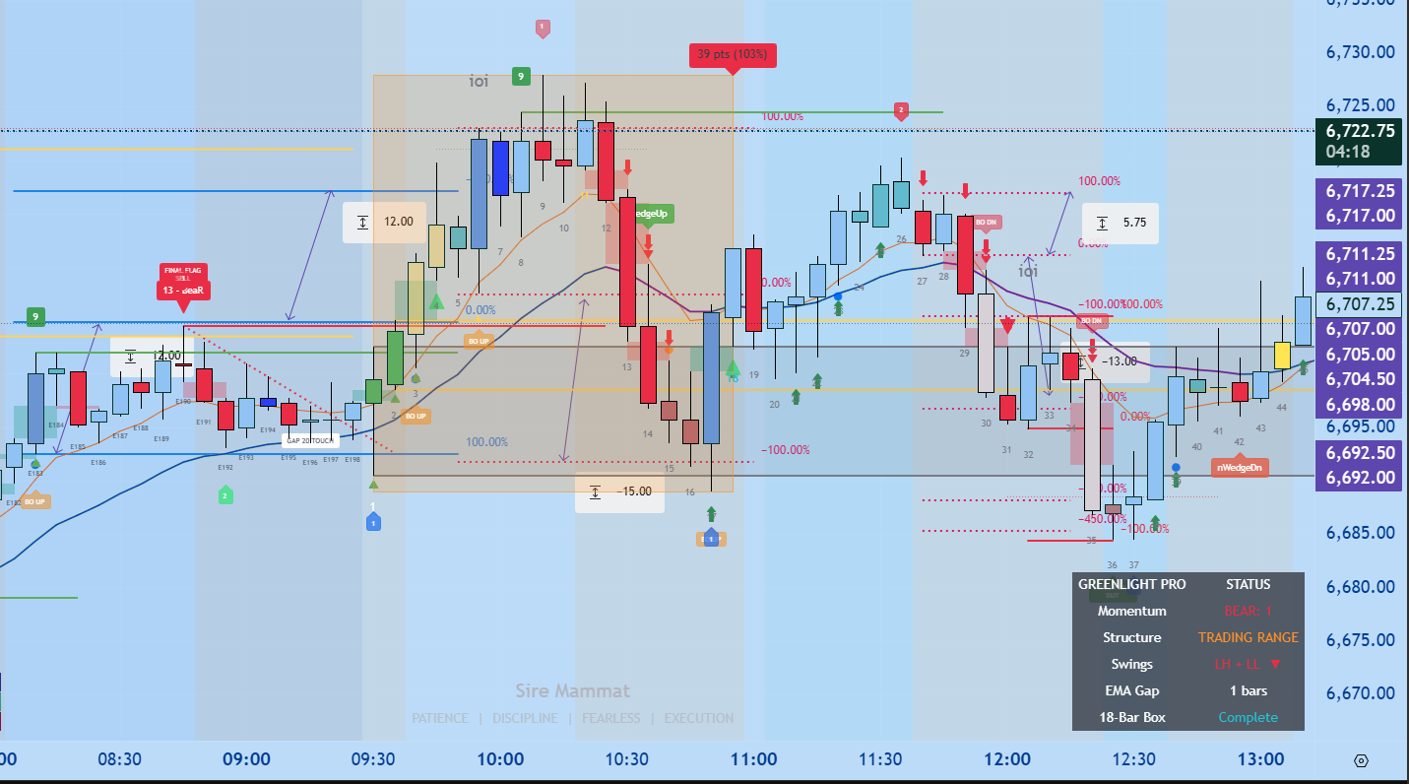
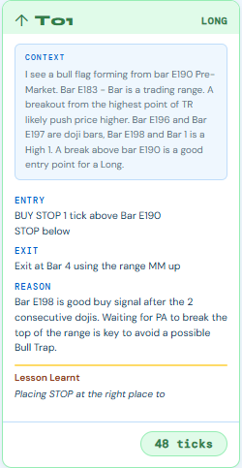
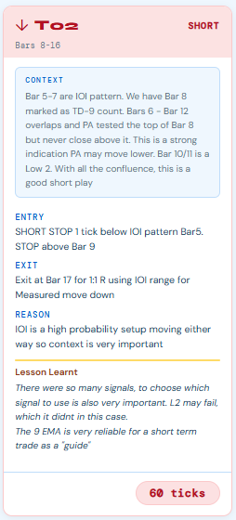
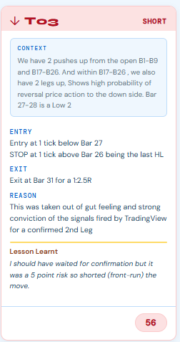
EOD REVIEW · MES · 5-Minute Bars
Mar 16, 2026
PRE-MARKET CONTEXT
Price Action was trending up since Sunday Open. This is strong indication of a reversal to the upside from Friday's low..
EOD Review: March 13, 2026 · MES 5m · Personal trade journal — not financial advice

Slide 3
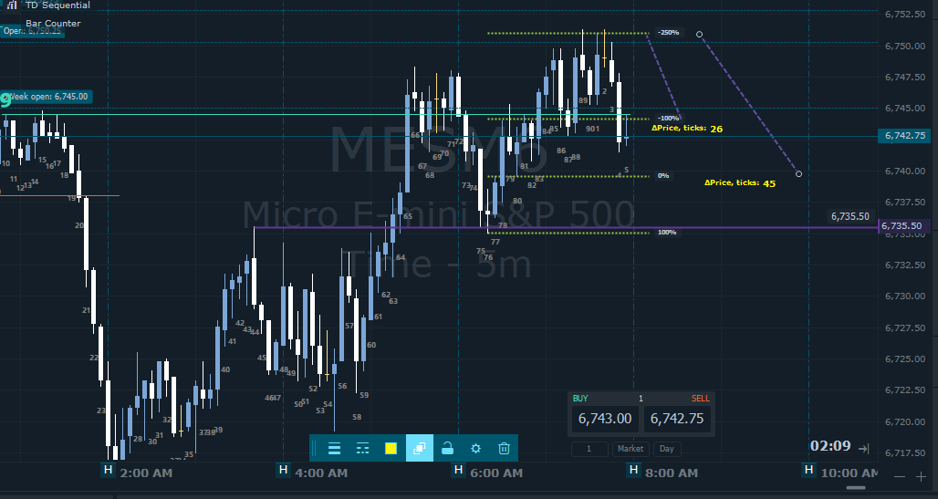
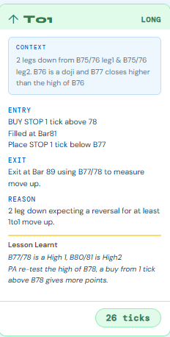

Slide 4
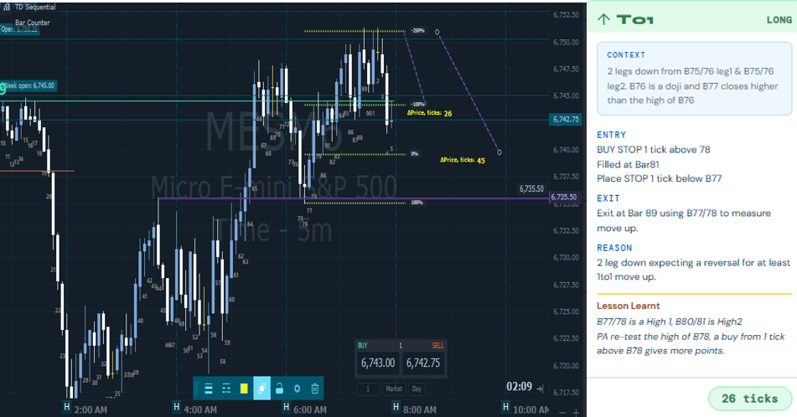

Slide 5
SESSION NOTES · MES 5m · Mar 13, 2026
Bar-by-Bar Context
Early Session · Bars 1–14
Mid Session · Bars 21–53
Key Observations · All Session
Bar 21/22: Low 2 — bearish inside bar, price below 20EMA with gap
Structure: Early session: Trending. Mid session: Trading Range from Bar 23 onwards
Price vs EMA: Price closes below EMA — bear trend context, EMA acting as resistance not support
EMA role: EMA acted as resistance in the afternoon — price unable to sustain above
Bar 22: Bearish inside bar confirmed — entry sell stop 1 tick below
Bear Flag: Classic Bear Flag Bars 10–14 led cleanly to T03 — 80 tick winner
Bars 23+: Bars start to overlap — strong indication price action is in a Trading Range
Pattern repeat: Bar 53 setup mirrors Bar 42 — trading pattern recognition
Bar 52: Strong Breakout Bar to the downside
T02 note: Risk was limited to ~40 ticks — bullish inside bar scalp in minor pullback
Bar 53: Weak buy signal bar — no follow-up bear bar after Bar 52
T03 conviction: Took trade for Bear Flag + expecting 2nd leg down — confirmed by Bar 13 Low 1
After Bar 42: BO Bar with no follow-up bear bar — high probability price repeats pattern from Bar 42
T04 context: Downtrend confirmed — bearish inside bar below EMA with gap is high conviction
Risk note: T05 risk was only about 30 ticks — very small if trade failed
Walk away: No T06 — overlapping bars from Bar 23 signal choppy range. Correct to stop.
SESSION RESULT · 5 Trades · T01 +39 · T02 +39 · T03 +80 · T04 +49 · T05 +30 · TOTAL: +237 TICKS
Bar 13 (EMA): Barely closing above EMA — "breakout" above EMA weak, essentially a false break

Slide 6

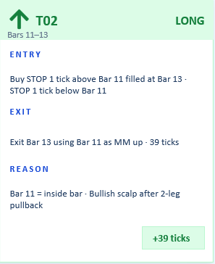

T01 · LONG · Bars 1–3
TRADE EXPLANATION · MES 5m · Mar 13, 2026
+39 ticks
TRADE EXPLANATION
What is the overnight high? What is the overnight low? Lines drawn.
Pre-market direction assessed — up or down from prior close
Two-leg structure checked — is a base complete?
TD9 count checked on pre-market bars
If TD9 fired in pre-market, mark that bar. It is a test target for the session.
Where is VWAP relative to current price? Above = bullish bias. Below = bearish bias.
Context
T01
The Trades
LONG
CONTEXT: Bars 52→1: Pre-market bars overlapping (IOI) — high probability reversal zone Bar 60/61/62: IOI pattern — Inside Outside Inside Bars confirming reversal
Bar 2: Outside Outside Bar (breakout bar) with long lower wick — buyers in control
Bars 1 & 2: High 2 structure — buying 1 tick above Bar 1 makes sense
ENTRY : Buy STOP 1 tick above Bar 1 · STOP 1 tick below Bar 2
EXIT : At Bar 3 using Bar 1 as Outside Bar to measure move up
REASON: Breakout from pre-market trading range · Bar 2 – OO expecting 1:1R minimum
OUTCOME:
Lesson Learnt
IOI pre-market compression followed by a strong Outside Bar breakout is a high-probability setup. The long lower wick on Bar 2 was the key confirmation — buyers were aggressively defending. Wait for Bar 2 close confirmation before entering.
+39 ticks
Trade 1 of 5 · EOD Review Mar 13, 2026 · Personal trade journal — not financial advice

Slide 7
T02 · LONG · Bars 11–13
TRADE EXPLANATION · MES 5m · Mar 13, 2026
+39 ticks
TRADE EXPLANATION
MES 5m · Bar 11 = Inside Bar (compression after pullback) · Entry STOP 1 tick above Bar 11 filled at Bar 13 · Stop 1 tick below Bar 11 · Target = MM up using Bar 11 as reference · Risk ~40 ticks
Charting
After a 2-leg pullback from the session high, Bar 11 formed an inside bar — a compression signal. Buying 1 tick above the inside bar makes sense as a quick bullish scalp in a minor pullback context. Risk was limited due to the tight inside bar range.
Trade Idea
+39 ticks · Exit at Bar 13 using Bar 11 as MM up · Risk was approximately 40 ticks
Outcome
Inside bars at the end of a 2-leg pullback in a trending session are clean scalp entries. The key is keeping risk tight — the inside bar naturally defines the stop. Do not hold through if the next bar fails to follow through.
Lesson Learnt
Trade 2 of 5 · EOD Review Mar 13, 2026 · Personal trade journal — not financial advice

Slide 8
T03 · SHORT · Bars 12–18
TRADE EXPLANATION · MES 5m · Mar 13, 2026
+80 ticks
TRADE EXPLANATION
MES 5m · Bear Flag Bars 10–14 · Bar 12/13 = Low 1 · Entry Sell STOP 1 tick below Bar 12 filled at Bar 15 · Stop 1 tick above Bar 12 · Target = MM down using Bar 12/13
Charting
Bear Flag formed between Bars 10 and 14 — a classic continuation pattern after the first leg down. Bar 13 was a Low 1 — no follow-through from bulls, momentum was fake. Wick on Bar 14 showed sellers actively rejecting highs. Bar 13 barely closed above EMA — essentially a false breakout. Expecting 2nd leg down.
Trade Idea
+80 ticks · Exit at Bar 18 using Bar 12/13 MM down · Largest winner of the session
Outcome
Bear Flags with a Low 1 at the flag top are one of the highest conviction short setups. The fake breakout above EMA on Bar 13 with no follow-through was the final confirmation. When the wick rejection and false EMA breakout align — size up with confidence.
Lesson Learnt
Trade 3 of 5 · EOD Review Mar 13, 2026 · Personal trade journal — not financial advice

Slide 9
T04 · SHORT · Bars 22–24
TRADE EXPLANATION · MES 5m · Mar 13, 2026
+49 ticks
TRADE EXPLANATION
MES 5m · Bar 22 = Bearish Inside Bar · Price below 20EMA with a gap · Bar 21/22 = Low 2 · Entry Sell STOP 1 tick below Bar 22 · Target = MM down using Bar 22
Charting
Bar 22 was a bearish inside bar with price clearly below the 20EMA — the EMA acting as resistance not support. The gap between price and EMA confirmed the downtrend context. Bar 21/22 formed a Low 2 structure. High conviction short in an established downtrend.
Trade Idea
+49 ticks · Exit at Bar 24 using Bar 22 as MM down · Clean execution
Outcome
Bearish inside bars below the EMA with a visible gap are textbook downtrend continuation entries. The EMA gap tells you the trend has momentum — do not fight it. Low 2 structure adds structural confluence. This is a core SIMPAN setup.
Lesson Learnt
Trade 4 of 5 · EOD Review Mar 13, 2026 · Personal trade journal — not financial advice

Slide 10
T05 · LONG · Bars 53–58
TRADE EXPLANATION · MES 5m · Mar 13, 2026
+30 ticks
TRADE EXPLANATION
MES 5m · Bar 52 = Strong BO Bar to downside · Bar 53 = Weak buy signal bar (no follow-up bear bar) · Entry Buy STOP 1 tick above Bar 53 · Stop 1 tick below Bar 53 · Target = 1:1 MM using Bar 53
Charting
Bar 52 was a strong breakout bar to the downside — but Bar 53 showed no follow-through from bears. This mirrors the Bar 42 pattern earlier in the session where a BO bar with no follow-up led to a reversal. Pattern recognition trade — hoping PA repeats what it did at Bar 42. Risk was very small at ~30 ticks.
Trade Idea
+30 ticks · Exit at Bar 58 at 1:1 MM · Low risk, high probability pattern repeat trade
Outcome
When a strong breakout bar has no follow-through on the next bar, it is a signal that the move may be exhausted. Pattern recognition across the same session is a valid edge — if Bar 42 showed the same setup and worked, Bar 53 deserves a trade. Small risk = easy decision.
Lesson Learnt
Trade 5 of 5 · EOD Review Mar 13, 2026 · Personal trade journal — not financial advice

